Slide 1





Sessions and Cookies
State Management, Cookies, Sessions, Hidden Fields
SoftUni Team
Technical Trainers
Software University
http://softuni.bg

Slide 2


Table of Contents
State Management in Web Applications
Working with Cookies
Working with User Sessions
Implementing Session-Based Counter
Implementing Login / Logout
Hidden Fields
Parameterized Address

Slide 3
State Management in Web Applications
The HTTP protocol is stateless
No built-in way to implement a stateful interaction (conversation)
Ways to preserve state between the HTTP requests:
Cookies (used by the PHP session)
Hidden fields (used to pass hidden data between pages)
Can be combined with HTML5 local storage / session storage
Parameterized addresses (used to implement cookieless sessions)
Session state is used in most Web applications: login / logout

Slide 4
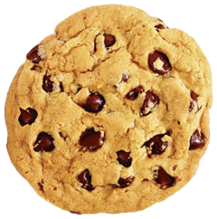

Cookies
HTTP
cookie
Working with Cookies in PHP

Slide 5
What is a Cookie?
Cookie == a small piece of data (up to 4KB)
Sent to the Web browser by the Web server
Saved locally inside the browser
Sent back by the browser in all subsequent requests
Cookies are created through the HTTP response header:
Browser sends the cookie back in the subsequent HTTP requests:
HTTP
cookie
Set-Cookie: UserID=baj.ivan; path=/; domain=nakov.com; Expires=Wed, 14 Jun 2015 10:18:14 GMT
Cookie: UserID: baj.ivan;

Slide 6
Cookies in PHP: $_COOKIE and setcookie()
Send cookies to be stored in the client's browser
setcookie(name, value, expiration)
Reading the cookies sent by the browser
$_COOKIE['cookie_name']
setcookie("user", "Nakov", time() + 5); // expires in 5 sec.
if (isset($_COOKIE["user"])) {
echo "Welcome " . $_COOKIE["user"] . "!<br>";
}

Slide 7
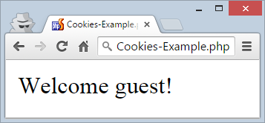
Cookies – Example
<html>
<body>
<?php
if (isset($_COOKIE["user"])) :
echo "Welcome " . $_COOKIE["user"];
else :
echo "Welcome guest!";
endif;
setcookie("user", "Nakov", time() + 5); // expires in 5 sec.
?>
</body>
</html>
Cookies-Example.php

Slide 8
Using Cookies in PHP
HTTP
cookie
Live Demo

Slide 9

Sessions
Session Management in PHP

Slide 10
What is Session?
A user session is a way to store data (in variables) to be shared between multiple server-side scripts (pages)
Session data is stored at the server-side
Survives during subsequent HTTP requests
Usually implemented by cookies + server-side session storage
In PHP session data is stored at the server in text files
Session data files are stored in the TEMP directory: /tmp
Can be configured to keep session data in memory or in database

Slide 11
User Sessions: Concepts
Sessions hold user-specific data at the server side
Sessions are automatically managed by the server-side runtime
PHP, ASP.NET and Java maintain a session object automatically
Each user browser has different user session
If you open the same site in Chrome and Firefox
You will have two different sessions (different users)
If you open the same site in two tabs in the same Web browser
Both tabs will share the same session data

Slide 12
PHP Sessions: $_SESSION and session_start()
In PHP $_SESSION is a global array holding the session variables
After session_start() it is auto maintained at the server-side
Cookies are automatically maintained by PHP to support the sessions
Developers just store and read values from $_SESSION[…]
<?php
session_start();
if (!isset($_SESSION['count'])) {
$_SESSION['count'] = 0;
}
echo "Session counter: " . ++$_SESSION['count'];
Session-Counter.php

Slide 13
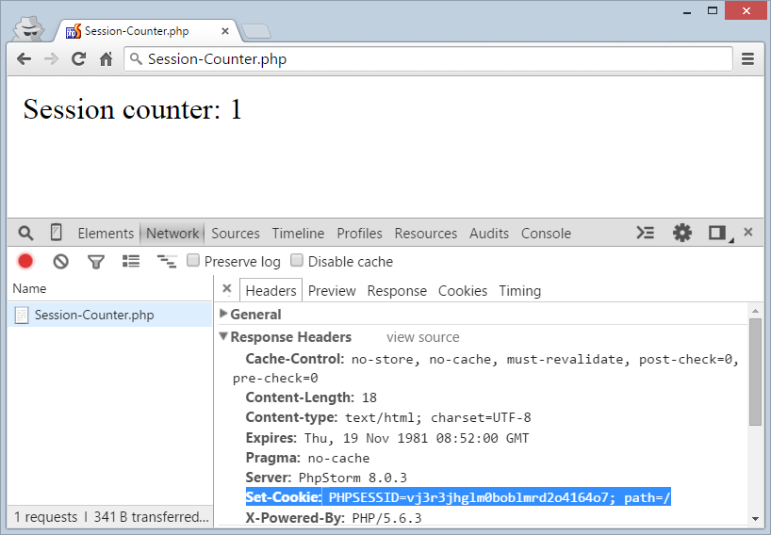
PHP Sessions in Action: First Request
At the first request a cookie PHPSESSID is sent to the browser
Holds a unique PHP session identifier
Generated at the server by crypto algorithm
Based on remote IP, current time + more

Slide 14
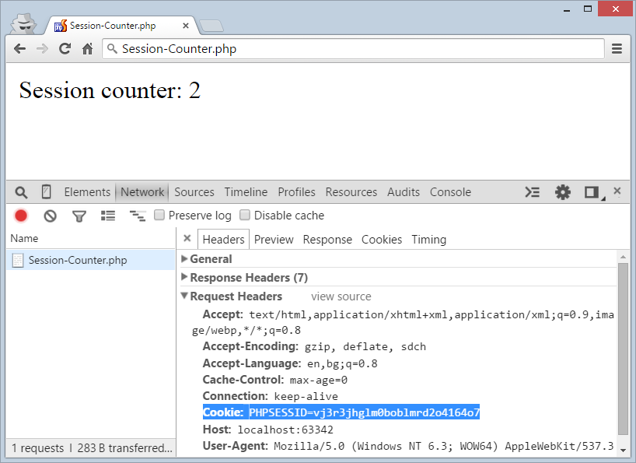
PHP Sessions in Action: Next Request
The browser sends back the PHPSESSID cookie at each subsequent request
Session dies when the browser is closed
No timeout by default (in the PHP implementation)

Slide 15

Session-Based Counter
Live Demo

Slide 16
Implementing Login / Logout in PHP
<?php if (isset($_POST['user'])) {
if (checkLogin($_POST['user'], $_POST['pass'])) {
session_start();
$_SESSION['user'] = $_POST['user'];
header('Location: main.php'); die;
}
echo 'Error: Invalid login.';
} ?>
<form method="post">
Username: <input type="text" name="user" /><br />
Password: <input type="password" name="pass" /><br />
<input type="submit" value="Login" />
</form>
login.php

Slide 17
Implementing Login / Logout in PHP (2)
<?php include('auth_header.php'); ?>
<h1>Hi, <?= htmlspecialchars($_SESSION['user']) ?>,
how are you?</h1>
<p>This page is for logged-in users only.</p>
main.php
<?php session_start();
if (isset($_SESSION['user'])) : ?>
User: <?= htmlspecialchars($_SESSION['user']) ?>
<div class="logout"><a href="logout.php">[Logout]</a></div>
<?php else :
header('Location: login.php');
die;
endif; ?>
auth_header.php

Slide 18
Implementing Login / Logout in PHP (3)
<?php
session_start();
session_destroy(); // Delete all data in $_SESSION[]
// Remove the PHPSESSID cookie
$params = session_get_cookie_params();
setcookie(session_name(), '', time() - 42000,
$params["path"], $params["domain"],
$params["secure"], $params["httponly"]
);
header('Location: login.php');
die;
logout.php

Slide 19
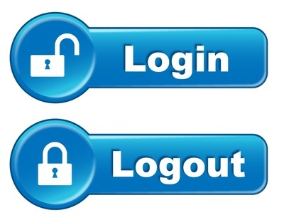
Implementing Login / Logout in PHP
Live Demo

Slide 20
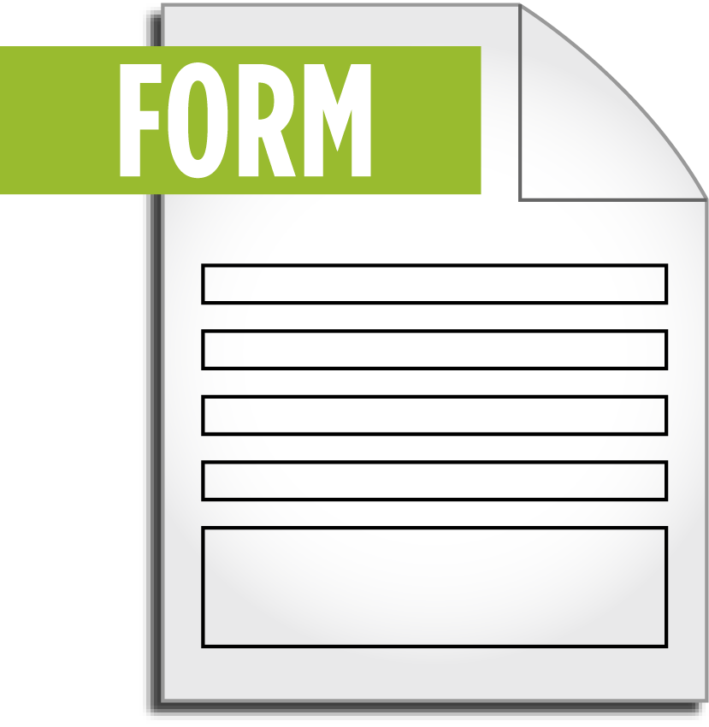
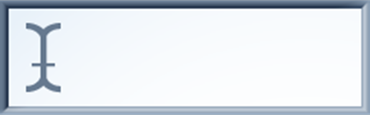

Hidden Fields
Preserving State in Hidden Form Fields

Slide 21
HTML Hidden Form Fields
HTML hidden form fields
Hold text data in the HTML form
Submitted as part of the form data
Not visible to the user (visible through the Browser inspector)
Hidden fields can preserve data between HTTP requests
Hidden fields data is loaded at some source page (PHP script)
Submitted to some destination page (PHP script)
<input type="hidden" name="ordernum" value="32653243" />
Hidden data

Slide 22
Transferring Data with Hidden Fields
Scenario:
Step1-Name.php enters customer name
Posts the data to Step2-Address.php
Step2-Address.php enters customer address
Saves the customer name in hidden field
Posts both customer name (hidden) + address (visible)
Step3-Confirm.php shows customer data
Both customer name and address come as POST data

Slide 23
Transferring Data with Hidden Fields
<form method="post" action="Step2-Address.php">
Name: <input type="text" name="name" /> <br />
<input type="submit" value="Next" />
</form>
Step1-Name.php
<form method="post" action="Step3-Confirm.php">
<input type="hidden" name="name"
value="<?= htmlspecialchars($_POST['name']) ?>" />
Address: <input type="text" name="address" /> <br />
<input type="submit" value="Next" />
</form>
Step2-Address.php
Name: <?= htmlspecialchars($_POST['name']) ?>
<br/>
Address: <?= htmlspecialchars($_POST['address']) ?>
Step3-Confirm.php

Slide 24
Transferring Data with Hidden Fields
Live Demo

Slide 25

Parameterized Addresses
Preserving State in URL Parameters

Slide 26
Parameterized Addresses
The idea is to hold state in the URL query strings
Setting the parameters in the URL of a page after the "?" sign:
Reading a query parameter:
Used to pass data from one page to another
Not popular technique (need to re-pass the parameters)
Sessions and hidden fields work better
http://localhost/index.php?tabid=2
$selectedTabID = $_GET['tabid'];

Slide 27
Using Parameterized Addresses
Live Demo

Slide 28









Sessions and Cookies
https://softuni.bg/courses/web-development-basics/

Slide 29
License
This course (slides, examples, demos, videos, homework, etc.) is licensed under the "Creative Commons Attribution-NonCommercial-ShareAlike 4.0 International" license

Slide 30





Free Trainings @ Software University
Software University Foundation – softuni.org
Software University – High-Quality Education, Profession and Job for Software Developers
softuni.bg
Software University @ Facebook
facebook.com/SoftwareUniversity
Software University @ YouTube
youtube.com/SoftwareUniversity
Software University Forums – forum.softuni.bg

